Slide 1
Mahatma Gandhi
Institution Affiliation
Date

Slide 2
Introduction
Mahatma Gandhi was an Indian leader known for his transformational and charismatic leadership.
Gandhi major achievement was leading the Indians to independence from the British.
Gandhi is known for his non-violence policy in solving conflict.
Notes:
Mahatma Gandhi is an Indian leader known for his role in achieving Indian independence from the British government. He remains one of the most respected leaders because of his leadership skills. Gandhi portrayed transformational and charismatic leadership that was guided by nonviolence.

Slide 3
Leading and Managing Change
Gandhi push for independence from the British government for the Indian people.
Gandhi had a vision, developed a plan and goals in the achievement of this change.
Effective communication of the vision and purpose to the people to rally support.
Notes:
Gandhi led and managed change through the push for independence from the British government. Gandhi had the vision to lead his people from colonialism and developed a plan to achieve their independence. Notably, in managing the change, he ensured that he communicated his dreams, purpose and plan effectively to the Indian people to rally support. He shared his goal during prayer meetings in which he explained to the people the purpose and answered all questions to facilitate the peoples understanding. Communication is essential in ensuring the people understand and provide their support in the achievement of the goal. Therefore, through his excellent communication skills, Gandhi explained his vision to the Indian people influencing them to join him.

Slide 4
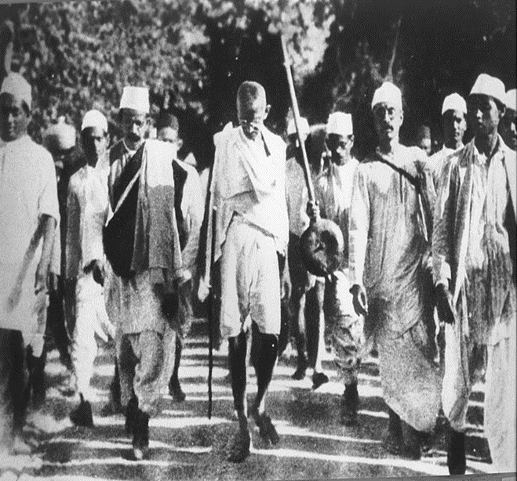
Problem Management and Decision Making
Gandhi identified the problem of segregation and taxation that the people of Indian origin were facing in South Africa (Dhupelia-Mesthrie, 2009).
Gandhi identified the problems resulting from the Salt Act in India leading to marches. (Singhal, 2010)
Gandhi decision making process involved problem identification, alternative identification selection and implementation of an adequate solution.
Gandhi during the salt march to Dandi.
Notes:
Gandhi portrayed his leadership skills in problem management and decision making. Gandhi was keen on identifying the problems that affected his people and embarked on a decision-making process to solve these problems. It was evident in his identification of segregation and taxation of the Indian people in South Africa, causing him to engage the people in protests and boycotts. Similarly, he identified the suffering of Indian people under the British government and decided on pushing for their independence. Further on identifying the specific problems, Gandhi looked at the alternative means of solving the issues ad implemented the most appropriate solution.

Slide 5
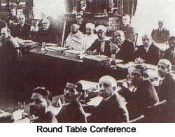
Consensus Building and Negotiation
Gandhi believed in non-violent methods of resolving conflict.
Gandhi engaged in negotiations leading to the Gandhi-Irwin Pact(Gupta, 2015).
Gandhi's negotiation strategies involved creating leverage for and uniting Indians.
Gandhi during one of the British round table conference.
Notes:
Gandhi is known for his nonviolence approach to solving conflicts which were referred to as Satyagraha. He believed in accommodating and converting the opponent without the use of violence and applied this with the British. Gandhi was involved in various negotiations on behalf of the Indian people. One of the significant negotiations led to the Gandhi-Irwin Pact, in which he was chosen to negotiate in place of the congress. Gandhi strategies of consensus building and negotiations were strategic and guided by the Indian people interests. He ensured that he united the Indian people to create leverage against the British people by transferring power to the Indian masses.

Slide 6
Conclusion
Gandhi portrayed transformational and visionary leadership in leading and managing change
Gandhi negotiation skills were critical in the achievement of his vision for independence for India
Application of Gandhi's leadership skills in my practice is fundamental in providing effective leadership.

Slide 7
References
Dhupelia-Mesthrie, U. (2009). Satyagraha in South Africa: Principles, practice and possibilities. Historia, 54(1), 13-33.
Gupta, M. (2015, August 21). How Gandhi Negotiated Independence. LinkedIn. https://www.linkedin.com/pulse/how-gandhi-negotiated-independence-manisha-gupta
Singhal, A. (2010). The Mahatma's Message: Gandhi's Contributions to the Art and Science of Communication. China Media Research, 6(3).

