Slide 1
PORCINE CIRCOVIRUS- Associated Disease
Viral Disease of the pigs

Slide 2
OUTLINE
Disease description
Causative agent
Epidemiology
Virulence and Persistence
Pathogenesis
Etiology and Transmission
Prevention and Treatment
Bibliography

Slide 3
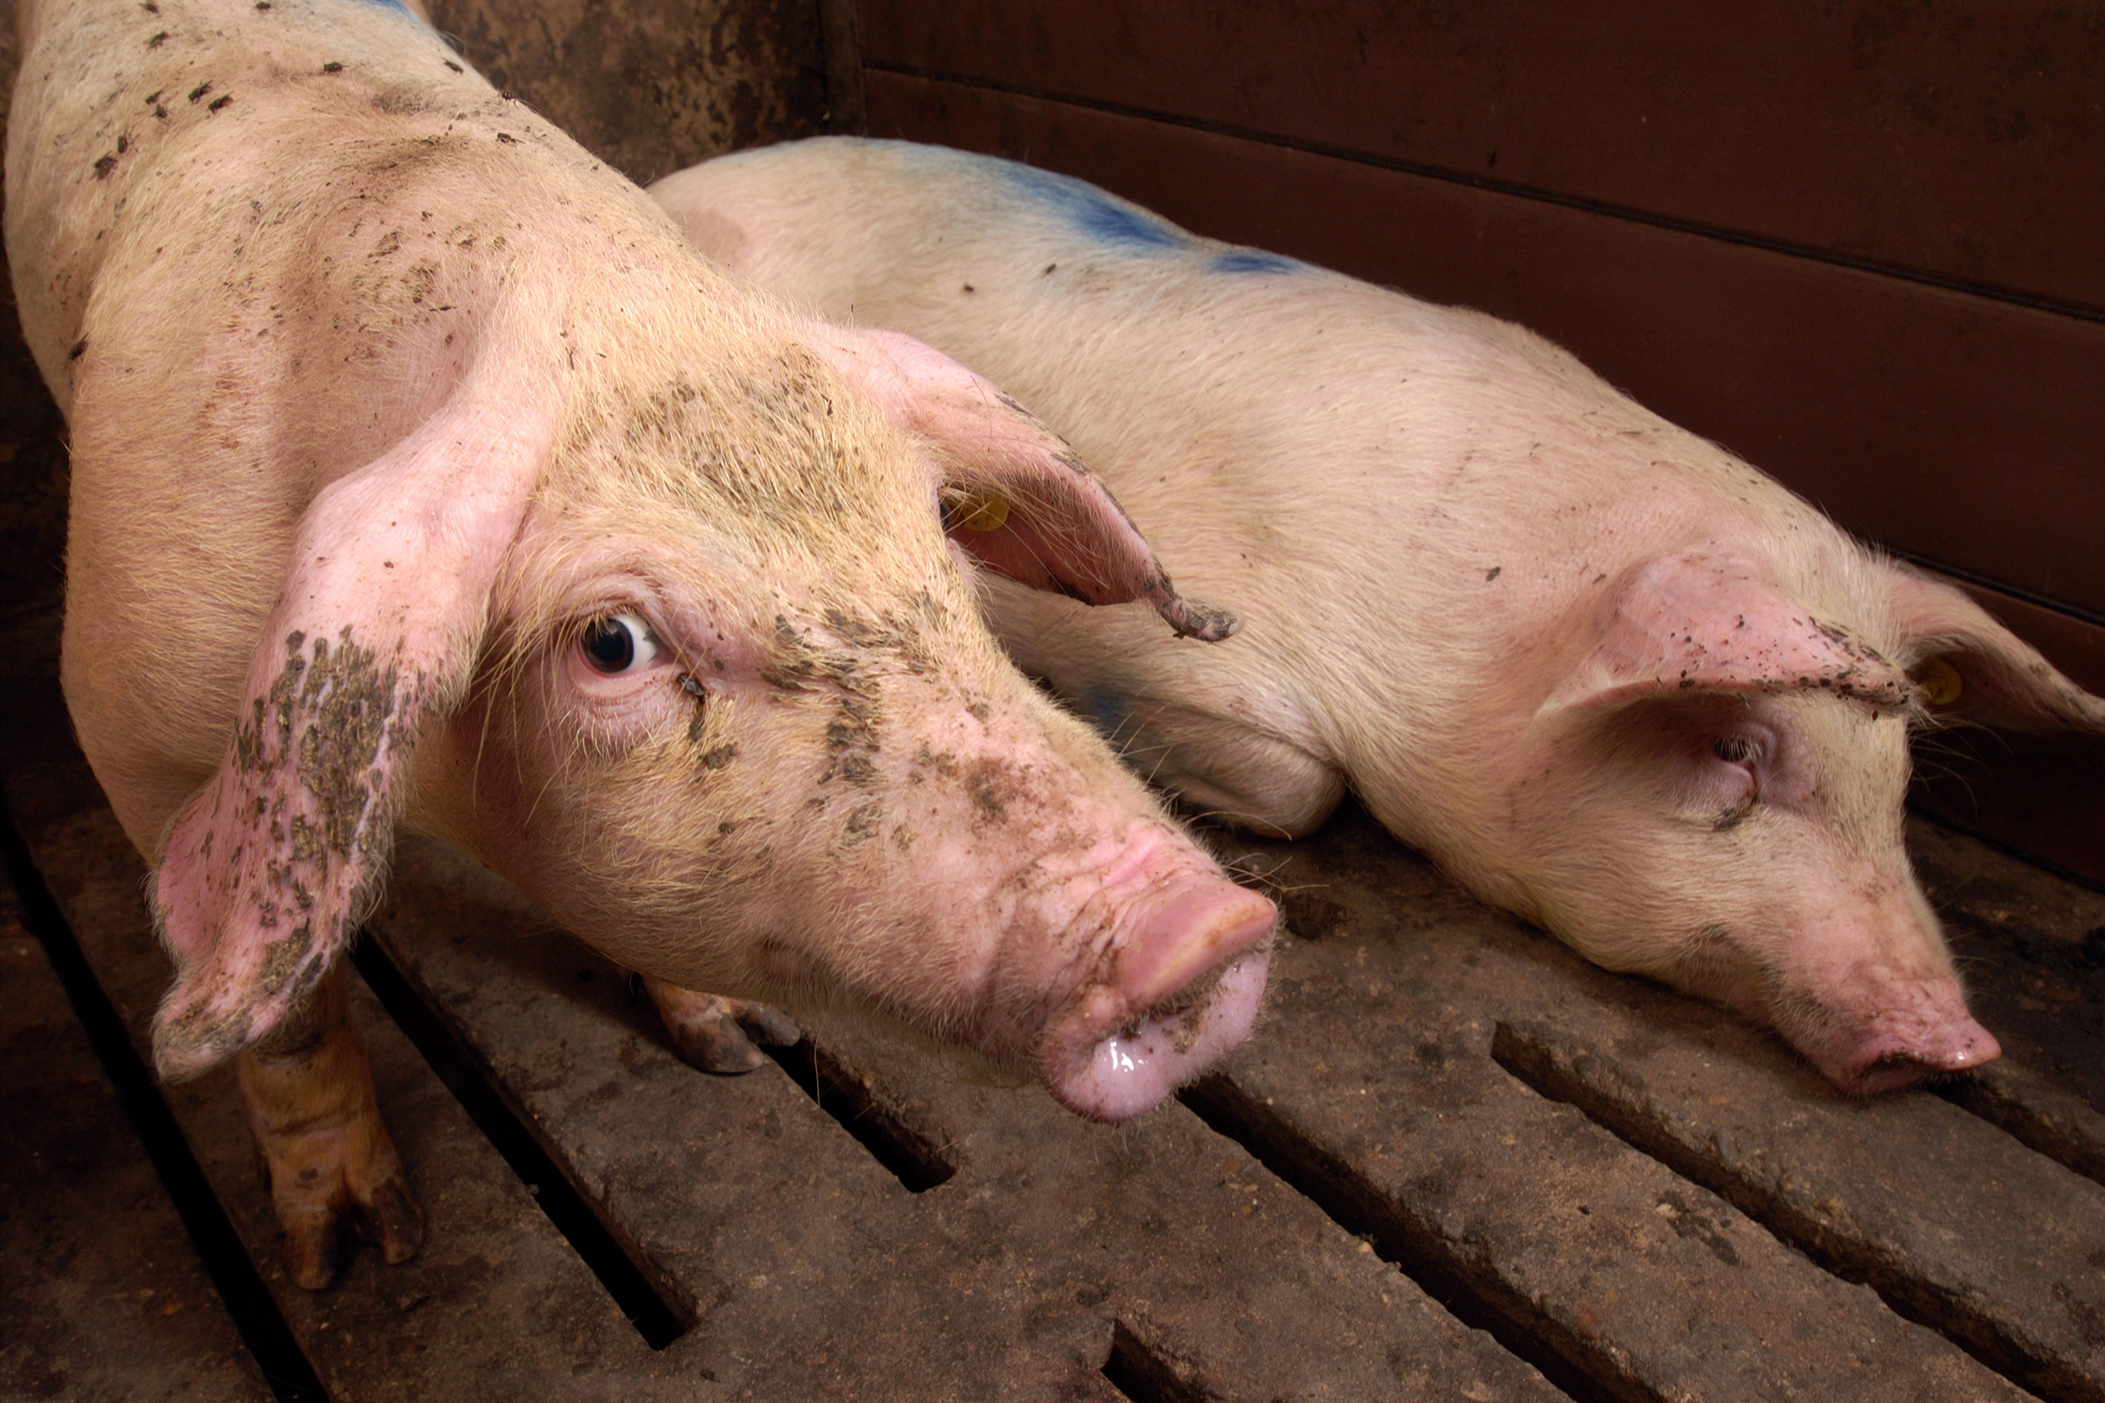
Disease description:
Common virus caused syndrome seen in pigs throughout the world.
Major problem for swine farmers in the U.S.
Clinical Signs and symptoms
  Weight loss
  Jaundice
  Poor growth
  Skin rashes
  Enlarged lymph nodes
  Stomach ulcers
  diarrhea
https://www.ncbi.nlm.nih.gov/pmc/articles/PMC7120144/#:~:text=Porcine%20circovirus%20(PCV)%20infections%20associated,form%20is%20PCV2%20subclinical%20infection.

Slide 4
Causative agent:
Major causative agent is Porcine circovirus type 2 (PCV2).
Porcine circovirus:
morphology
  Small
  Non enveloped
  Icosahedral
Genomic organization:
  Single stranded negative-sense circular DNA
  Genome size; 1767-1768
  11 predicted ORFs
https://www.ncbi.nlm.nih.gov/pmc/articles/PMC7120144/#:~:text=Porcine%20circovirus%20(PCV)%20infections%20associated,form%20is%20PCV2%20subclinical%20infection.

Slide 5
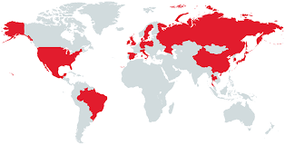
EPIDEMIOLOGY
Most pigs are infected with the PCV2.
However, only a small percent show and are affected with clinical signs.
High prevalence infection but low morbidity
Varying morbidity rate; 2-30%
Case fatality of 80%
Geographically:
  U.S, Asia, Europe and South America
https://vetmed.iastate.edu/vdpam/FSVD/swine/index-diseases/circovirus
https://www.hindawi.com/journals/av/2017/6807964/

Slide 6
Virulence and persistence
No PCV marker for virulence currently identified.
All swine breeds are susceptible
Maternal antibodies offer protection up to 12-16wks.
Virus target lymphoid tissue
Causes lymphoid depletion and immunosuppression
Allowing for viral persistence.
Disease is exacerbated by coinfection with other pathogens
https://pubmed.ncbi.nlm.nih.gov/25387012/#:~:text=Porcine%20circovirus%20type%202%20(PCV2)%20is%20the%20primary%20causative%20agent,depletion%20and%20immunosuppression%20in%20pigs.
https://www.ncbi.nlm.nih.gov/pmc/articles/PMC7166794/

Slide 7
Pathogenesis
Related to the immunomodulatory effects of the virus
Can multiply in different cell types
  epithelial cells, mononuclear cells, endothelial cells, fibrocytes,
Virus replication in actively dividing lymphocyte is increased.
Infection results in decreased:
  expression of B‐cell growth factor IL‐4
  Cytotoxic T cell and macrophage‐activating cytokine IL‐2
  Leading to virus persistence
https://www.ncbi.nlm.nih.gov/pmc/articles/PMC7166794/

Slide 8
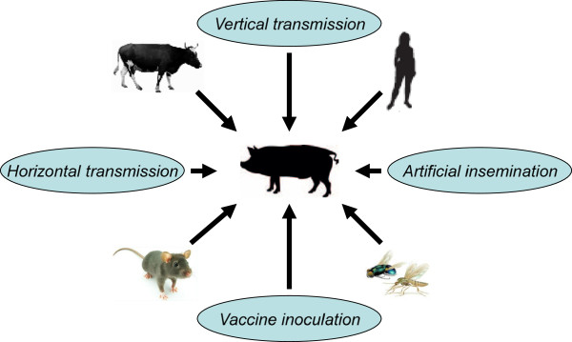
Etiology and Transmission
Etiology:
  Porcine circovirus are DNA viruses
  Genus: Circovirus
  Family: Circoviridae
Transmission
  Multifactorial spreading potential
    Pig to pig, cattle to pig
    Rodent to pig
    Pen environment to pig
Possible due to the numerous routes of exit of virus:
    Oronasal secretions
    Faeces and Urine
    Colostrum and Milk
    Semen from infected boar
https://www.ncbi.nlm.nih.gov/pmc/articles/PMC7120144/#:~:text=Porcine%20circovirus%20(PCV)%20infections%20associated,form%20is%20PCV2%20subclinical%20infection.
https://www.hindawi.com/journals/av/2017/6807964/

Slide 9
Prevention and Treatment
Treatment
Prevention
No specific treatment available for pigs
Anti-inflammatories and antibiotics sometimes used to prevent secondary bacterial infections.
Isolation of infected pigs
Vaccination: Available since 2006.
  Circovac: Adjuvanted vaccine with inactivated virus.
  Ingelvac Circoflex
  Circumvent PCV G2
https://vetmed.iastate.edu/vdpam/FSVD/swine/index-diseases/circovirus

Slide 10
Literature cited
Gillespie, J., Opriessnig, T., Meng, X. J., Pelzer, K., & Buechner-Maxwell, V. (2009). Porcine circovirus type 2 and porcine circovirus-associated disease. Journal of veterinary internal medicine, 23(6), 1151–1163. https://doi.org/10.1111/j.1939-1676.2009.0389.x
Kayode O. Afolabi, Benson C. Iweriebor, Anthony I. Okoh, Larry C. Obi, "Global Status of Porcine circovirus Type 2 and Its Associated Diseases in Sub-Saharan Africa", Advances in Virology, vol. 2017, Article ID 6807964, 16 pages, 2017. https://doi.org/10.1155/2017/6807964
Lian, H., Liu, Y., Li, N., Wang, Y., Zhang, S., & Hu, R. (2014). Novel Circovirus from Mink, China. Emerging Infectious Diseases, 20(9), 1547-1549. https://doi.org/10.3201/eid2009.140015.
Meng XJ. Porcine circovirus type 2 (PCV2): pathogenesis and interaction with the immune system. Annu Rev Anim Biosci. 2013 Jan;1:43-64. doi: 10.1146/annurev-animal-031412-103720. Epub 2013 Jan 3. PMID: 25387012.
Saikumar, G., & Das, T. (2019). Porcine Circovirus. Recent Advances in Animal Virology, 171–195. https://doi.org/10.1007/978-981-13-9073-9_10
Tischer, I., Mields, W., Wolff, D. et al. Studies on epidemiology and pathogenicity of porcine circovirus. Archives of Virology 91, 271–276 (1986). https://doi.org/10.1007/BF01314286

