Slide 1
D&M Inc.
Financial Performance Analysis and Recommendations

Slide 2
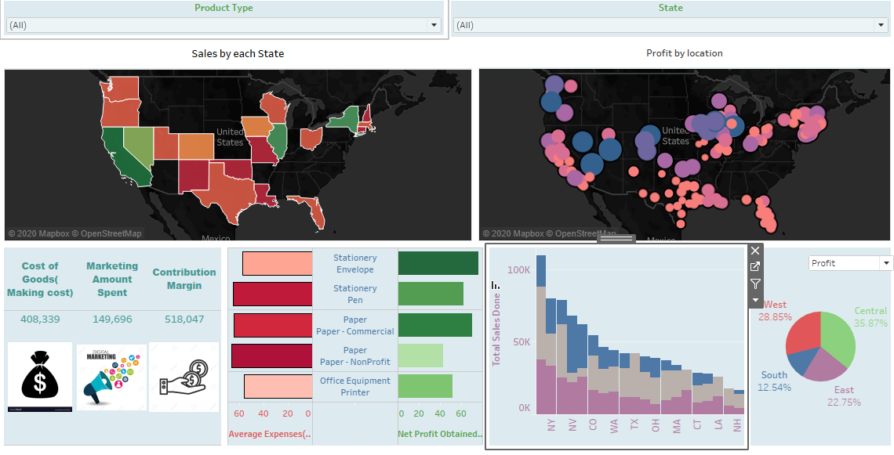
Result Summary

Slide 3
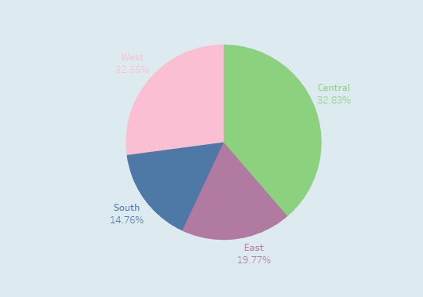
Sales Revenue – Regional Comparison
Notes:
Company revenues were primarily generated from four regions namely North, South, East and West. Comparison of revenues across regions indicates that the company was able to generate highest level of revenues in Central region whereas lowest revenues were attained in South Region. Specifically revenues generated in West region were 32.83% whereas total revenue generated in South region was 14.76%.

Slide 4
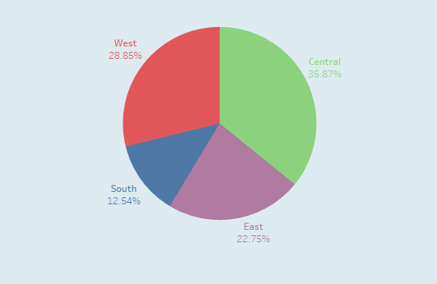
Net Profit – Regional Comparison
Notes:
Trends in overall net income distribution across regions follows a trend similar to that observed in revenue distribution. Specifically, regional income distribution follows the same hierarchy as the company revenues with central region making the highest contribution to company margins whereas South region which had the lowest levels of sales generated the lowest contribution of margins. The observed indicates that company cost structures and sales mix across regions remain similar hence allowing it to maintain similar trends in revenues and margins.

Slide 5
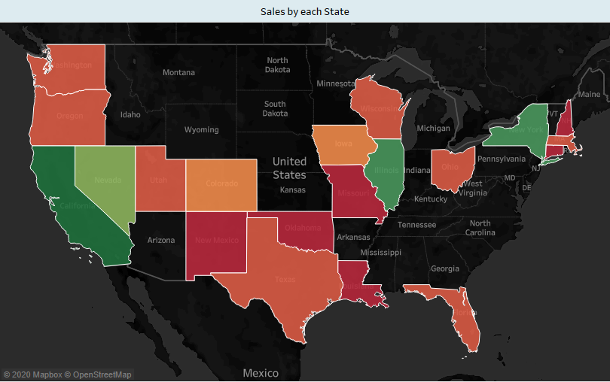

Sales Distribution – State Level
Notes:
Further breakdown of company revenues within regions was carried out to identify States which made the largest contributions to company sales. In this regards within Western States California was identified as the state which contributed most to company sales within the region and across the country. Similarly, New York generated highest levels of revenues in Eastern region followed by Illinois in Central region. An interesting trend observed here was that despite Central region leading overall revenue generation at individual state level revenue generation was lead by large urban centers of New York and California.

Slide 6
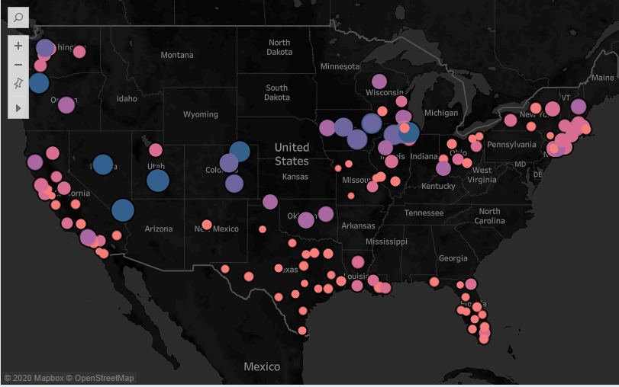
Net Profit– State Level
Notes:
State level profitability trend was inline with the distribution of revenues discussed in previous slide. Specifically, highest levels of profits were observed in the state of California followed by New York. The relationship of trend between company revenues and profits indicates that company cost structures which were observed to be consistent across regions were also consistent across states.

Slide 7
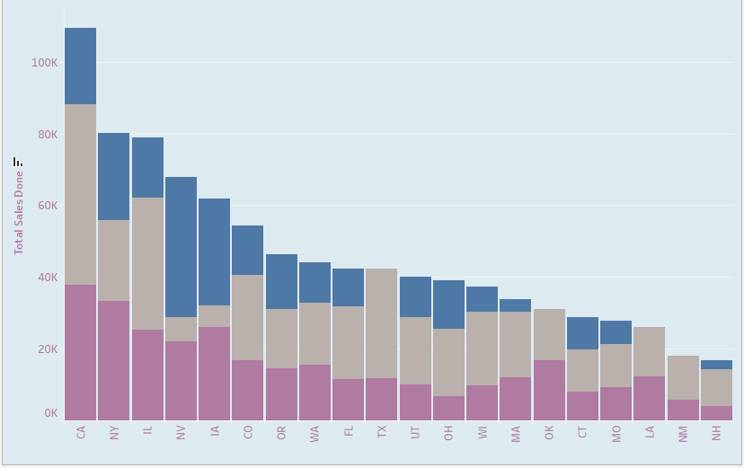
Product Level Sales – By State
Notes:
Further analysis of state level sales at individual product level was used to identify the product lines which were driving sales in individual states. In this regards it was observed that in the state of California which was generated highest levels of sales across all states the paper sales were driving the overall sales followed by stationary. IN contrast paper sales made up the smallest component of overall sales for the state of New York. Interestingly no office equipment was sales were observed in the state of Texas and Oklahoma.

Slide 8
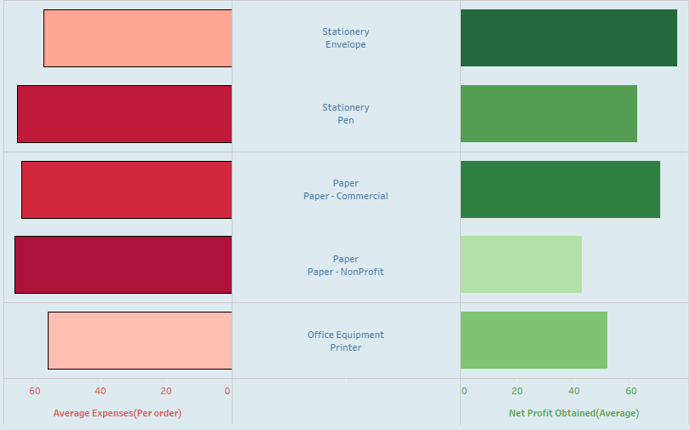
Product Level Expenses and Profits
Notes:
Analysis of profits and expenses at individual product level indicate that lowest levels of average profits were generated on sales of Non-Profit Paper which also had the highest cost whereas highest average profits were generated on Stationary envelope which had an average profit of 76.06 based on an average cost of 57.48. An interesting trend observed here was that while average cost per order was lowest for Printers they were able to generate comparatively low profits as compared to pens which despite having high average cost per order generated much higher profits. The trend may be explained by looking at individual product revenues and selling prices which lead to differences in net margins.

Slide 9
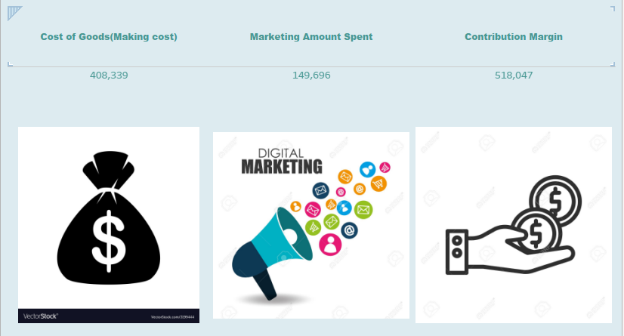
Cost Breakup
Notes:
Comparison of overall costs incurred by the company indicate that the cost of goods sold made up the largest cost component for the company whereas marketing costs made up almost 37% cost of sales and 16% of company sales. Further analysis at product level identified that equipment sales had the highest levels of direct costs where cost of sales made up almost 47% of sales whereas paper sales were accompanied by highest levels of marketing costs which made up almost 17% of total paper revenues. Overall Stationary sales generated the highest contribution and net profit margin.

Slide 10
Recommendations
Increased focus on sale of stationary product line;
Lower marketing expenditure on non-profit paper product sales;
Focus on achieving change in product sales mix to ensure higher ales of items with higher contribution and profit margins.
Notes:
Based on analysis of results following recommendations were made to the company management;
Increased focus should be placed on sale of stationary items which generate highest levels of margins and contributions.
Lower level of marketing expenditures should be made on sale of paper which currently incur highest proportion of marketing costs.
For high sales generating states such as New York and California company should reevaluate its sales mix to ensure revenue mix can be improved to increase a higher proportion of products which generate higher margins. For instance California revenues currently have paper sales leading its overall sales mix which is an item associated with lower margins.

