Slide 1
Insurance Providers
Employee health insurance is the assistance offered by a person's boss to the workers.
Notes:
Workers health insurance means the assistance provided by the company or the employer to the employees for medical care. In this case the boss pays either the full amount or part of the amount of the premiums. The insurance cover caters for the employee and his or her family as well. These insurance benefits can as well be used by the employee in times of need. Employees also go for check ups catered by the insurance.

Slide 2

Benefits to the employees through health insurance plan
Employees get medical checkups.
Insurance saves money
Easy access to family health insurance
Improves employee satisfaction
Reduces absenteeism at work
Notes:
Insurance is very important for a worker because for one, he or she knows that their family members are safe in case of any illness. Not forgetting that health care is very expensive especially in chronic cases with insurance one can relax knowing that the hospital expenses are catered forKirkland, A., Talesh, S., & Perone, A. K. (2021). Another benefit is that it saves the employee money because they do not have to use cash from the pocket. Staff are able to go for health checkups this resulting in satisfaction at work knowing that one is healthy and the family as well hence reducing absenteeism and increasing job productivity.

Slide 3
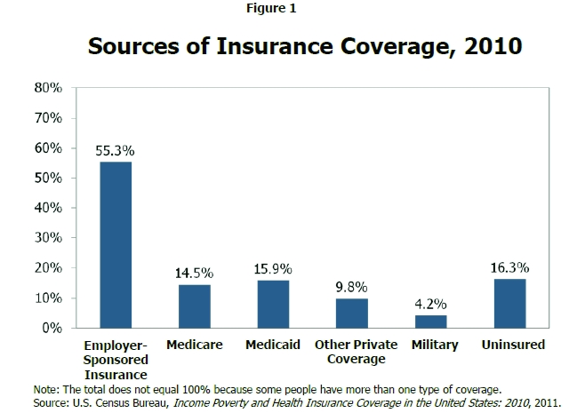
Role of employer in regards to premiums
Calculating and collecting premiums
Pay premiums and report hours and wages
Inform the workers about the benefits.
Notes:
The paid medical and family leave is backed by premiums. The premiums are either paid by the employer or the workers themselves. Therefore bosses need to calculate these premiums according to the agreed amount with the insurance and pay the money on behalf of the employees or withhold the amount from the workers check so that they can submit to the insurance. Additionally, rendering from the law employers ought to update the workers about their paid premiums or any other notices related to insurance (Dionne, G. (Ed.).2000). The reason is workers need to be aware of the updates on premiums to know the amounts they ought to spend on their health care.

Slide 4

Mutual benefit for worker and employer.
1. Deductible tax
2. Saves on premiums with wellness plans
3. Coverage acts as a repayment
4. Benefits with retaining
Notes:
When filing tax returns, employers can cut costs linked to tax since they perceive it as business and on the other hand workers benefit since health covers are not taxed. Workplace wellness is quite essential since it reduces absenteeism while workers get a chance to stay healthy due to regular check ups and save pocket cash (Dionne, G. (Ed.). (2000). Worker paybacks are branded as such since they offer measurable gain to staffs. Businesses that recompense staffs are more probable to draw top-tier. Job security is highly valued, when workers are sensitized to stay they search elsewhere, hence health cover retains workers.

Slide 5
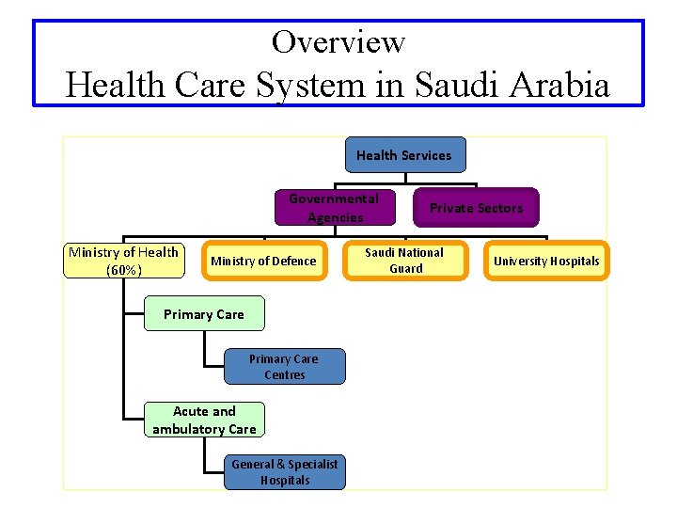
How Saudi Arabia and the other GCC nations fund public health services;
Health cover is
mainly backed
by the government
Notes:
In Arabia, health is mainly maintained by the government (75 %) or via the expenditures (roughly 25% ). The least sum of individual insurance which is already involved in the provision of healthcare facilities has been noteworthy. Government initiatives buy insurance (Alshammari, A. A., Alhabshi, S. M. S. J., & Saiti, B. 2018). For instance, Saudi Arabia experiences great costs together with great concerns regarding excellent health care in public facilities. Thus, the government needs to get cash provided by the public to cater for the health of its citizens and foreigners as well. This changes the health care system in both private and public sectors.

Slide 6
Comparison of Qatar insurance company and Bupa Health Insurance
Qatar insurance company is the market forerunner in Qatar as well as a central head in the GCC and MENA area. QIC is among the utmost esteemed insurers in the Gulf region on the other hand, BUPA Global offers global health and travel cover policies worldwide. Its services are accessible anywhere in the world.
Notes:
The Qatar insurance company is listed to be the best flag insurer for approximately 50 years now. The company which is Qatar-based is known to specialize in private and corporate asset protection. Additionally, Bupa insurance company is recognized for providing medical cover all over the world. Bupa designs an individuals health care system with the local medical system in mind. It has a brilliant reputation. The insurance covers family members as well despite the fact that it is international. The only difference between the two insurance companies is that Bupa offers its services globally but Qatar only insurers its citizens.

Slide 7
The role of moral hazard in health-benefits plan.
The theory of ethical hazard is quite tricky in the financial field since people are so eager to take the added risk if covered or not.
Notes:
Moreover, the common clients do not anticipate to take the advantage of a health insurer. It's possible that such is illegal, dishonest, and unpleasant. The added health service that is paid when people get insured is referred to this as a "moral hazard." According to popular wisdom, these higher health transactions are wasteful as they reflect care that is less beneficial for customers than what it costs to supply (HEC Forum, Vol 27). Chances are that the persons who are insured tend to consume more care in comparison to the health care costs they share. Moral hazard helps people move to the effectual consumption level.

Slide 8
References
Kirkland, A., Talesh, S., & Perone, A. K. (2021). Transition Coverage and Clarity in Self-Insured Corporate Health Insurance Benefit Plans.
Exploring the potential for moral hazard when clinical trial research is conducted in rural communities: Do traditional ethics concepts apply?. In HEC Forum (Vol. 27, No. 2, pp. 171-187). Springer Netherlands.

Slide 9
Alshammari, A. A., Alhabshi, S. M. S. J., & Saiti, B. (2018). A comparative study of the historical and current development of the GCC insurance and takaful industry. Journal of Islamic Marketing.
Ghobadian, A., & O'Regan, N. (2011). Successful strategy making in Bupa not‐for‐profit provident: A case study and interview with Mr Ray King, chief executive of Bupa. Journal of Strategy and Management.

Slide 10
Dionne, G. (Ed.). (2000). Handbook of insurance (pp. 155- 183). Boston: Kluwer Academic Publishers.
Baicker, K., & Levy, H. (2008). Employer health insurance mandates and the risk of unemployment. Risk Management and Insurance Review, 11(1), 109- 132.

