Slide 1
Technology in Special Education
Name
Institution

Slide 2
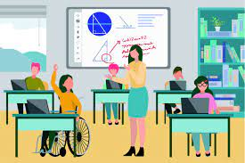
Introduction
Special education is moving away traditional learning model.
This means that teachers are hardly embracing lecturing and taking notes.
Instead of sitting in rows, technology has dominated the education setting (Altinay et al., 2016).
The aspects which will be explored in details include forms of technology and the aspects considered before they are selected.
Notes:
In the present generation, special education has shifted from traditional learning given that it hardly meets the unique demands of learners living with disabilities. That is, educators have been adopting latest technology devices and techniques in their instructions (Altinay et al., 2016). It also means that they have been adopting technology tools which leads to collaborative learning in the classroom. An interactive classroom allows the students to solve their problems easily. The aspects which will be covered below entail technology which assist learners with disabilities, tools which enhance their collaboration, and elements considered before they are selected.

Slide 3
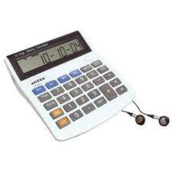
Technology that Improves Student’s Learning
(Talking Calculators)
Learners with dyscalculia can really benefit from a talking calculators.
The devices makes it simple for them to read numbers.
They also allow them to perform calculations and check numbers (Altinay et al., 2016).
Whereas talking calculators are fairly simple tools, they provide exceptional privilege for students.
Notes:
Students with disability such as dyscalculia can greatly benefit from talking calculators. This type of tool normally benefits individuals struggling with mathematics. The auditory feedback of talking calculators allows learners to check the accuracy of the keys that they press and verify answers before they add them in the paper. Students can also use them in a bid for checking their spelling or enhance their reading comprehension skills. Talking calculators assists learners given that they have in speech synthesizers which reads loudly each symbol, number and many other operation keys that the learners presses (Altinay et al., 2016).

Slide 4
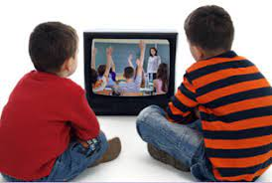
Technology that Improve Student’s Learning Cont’d (Videotaped Social Skills)
Learners with autism and other learning disabilities might struggle to socialize with others.
However, with videotaped social interactions, these learners can learn vital life skills (Altinay et al., 2016).
They can also be exposed to imperative social behavior which can allow them to easily connect with other learners.
Video taped skills can also eliminate academic and linguistic problems.
Notes:
Autistic children normally experience hurdles to socially interact with other learners. In the past years, these learners were exposed to socially interactions via practicing them. Unfortunately, many autistic learners involuntarily behaved inappropriately as they attempted to study vital social interactions (Altinay et al., 2016). Through the video taped social interactions, autistic children can study imperative social interactions. Video social interactions can further enable them to overcome their emotional, linguistic and academic problems.

Slide 5
Technology that Improves Student’s Learning Cont’d (Variable Speed Recorders)
Each learner has a diverse learning style.
Also, many learners struggle to understand auditory lectures.
However, with the help of variable speed recorder, the above mentioned can be curbed (Taylor, 2019).
In essence, learners only have to hit record whereas they are in class.
Notes:
The variable speed recorder has dominated the field of special education as a result of its ability to speed up or slow down recorded text. Learners living with disabilities uses this tool by recording their speeches when they wish, through the assistance of variable speed tape recorders (Taylor, 2019). After finishing the recording, they can play them at variable speeds based on convenience of the users. When pitch of the recording is difficult for the learners to understand, they can adjust pitch up or down in a bid for enhancing accessibility of their lecturers. Variable speed recorders are effective for learners who struggle with auditory problems.

Slide 6
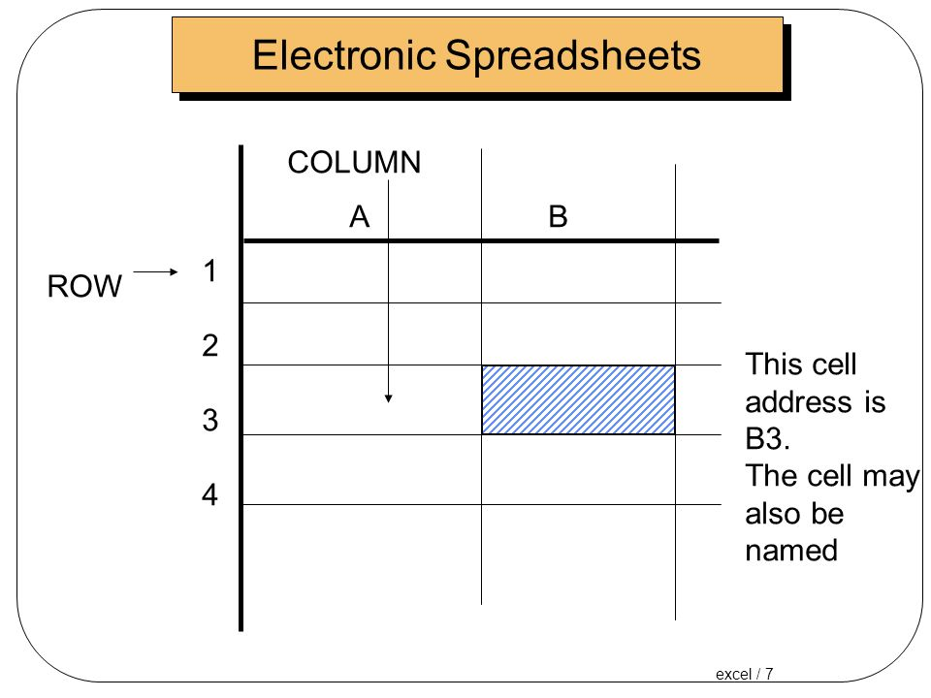
Technology that Improve Student’s Learning Cont’d (Electronic Worksheet)
  Students with dyslexia use electronic worksheets in a bid for completing their assignments.
  Electronic worksheets assists learners to line up equations and words on their assignments.
  It also helps them to line up equations.
  In some worksheets, even speech synthesizing technology is present (Taylor, 2019).
Notes:
In the past, when learners intended to internalize and practice knowledge and skills which they gathered in the classroom, educators traditionally issued them workbooks. Then, along came the electronic worksheets which have helped students with learning disabilities to complete their assignments. The electronic sheets helps learners to line up numbers as well as equations on the assignments they are issued by their teachers. The interactive aspects of electronic worksheets entirely engage the learners when it comes to learning. The presence of speech synthesizing technologies on the worksheets also makes them to be effective for learners (Taylor, 2019).

Slide 7
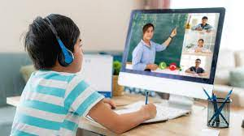
Technology for Collaborative Use (Web Based Service)
This form of distance learning is suitable for students who face problems linked with moving over longer distances.
Web based education permits offering learning services taking into account the needs of learning organizations and learners.
Devengo and XB Chat represent such tools (Taylor, 2019).
This form of learning is imperative especially since the pandemic began.
Notes:
Neat and intuitive web-based chatting tools permit developing of online classes which assist learners living with disabilities to communicate. The web based service tools permits educators and learners from diverse parts of the world to get involved in live classes. Web-based chatting is effective given that it cost effective. It is also efficient since it takes into consideration both the wants of the organization and the students. Some of the web-based chatting applications are XB Chat and Devengo (Taylor, 2019). In fact, this tool has been effective for students living with disabilities since COVID-19 pandemic began.

Slide 8
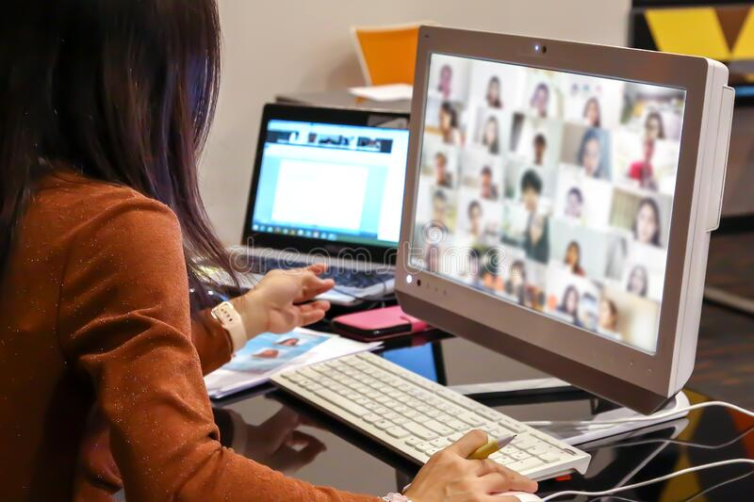
Technology for Collaborative Use Cont’d (Videoconferencing System)
A videoconferencing system allows learners to connect with students globally.
In this way, learners understand new cultures(Viner, Singh & Shaughnessy, 2020).
They are also exposed to new experiences.
The benefit of this technique is that learners interact without incurring the cost of travelling.
Notes:
Videoconferencing system in the education setting is is a live based video based meeting between 2 or more learners in diverse part of the world using video enabled devices. This technology permits many individuals to meet and collaborate virtually by transmitting text, presentations and so on via the internet. With the help of videoconferencing tools, students can understand the unique way of life in different parts of the world (Viner, Singh & Shaughnessy, 2020). They can also discover techniques which they can implement to boost their social interaction. One of the benefit connected with the videoconferencing is that students living with learning disabilities connect without incurring any financial cost.

Slide 9
Technology for Collaborative Use Cont’d ( Wireless Presentation System and Collaborative Software)
Wireless presentation systems and collaborative software permit educators and learners to share content.
Specifically, content is shared from mobile devices and displayed on the screens for the students to see.
Apart from content, students can be exposed to skills which can enable them to connect effectively.
An example of wireless presentations systems and software is Apple TV(Viner, Singh & Shaughnessy, 2020).
Notes:
The other collaborative tool which learners living with disabilities and teachers can use in the classroom is wireless presentation system and collaborative software. The users of this collaborative tool normally share their content using mobile devices. In this way, they are displayed on the screens so that the students can see them vividly in the classroom. This tool also enable the learners to recognize the skills and ideas that can enhance their social interaction. Apple TV is one of the example of wireless presentation systems that many users normally use to expose their learners to their content (Viner, Singh & Shaughnessy, 2020).
.

Slide 10
Considerations Regarding Access (Budget Considerations)
First of all, educators should look at the cost they will incur in the tools they intend to use.
They should specifically purchase tools which are cost effective.
However, they must be careful not to acquire technology which will be replaced frequently(Viner, Singh & Shaughnessy, 2020).
Educators should not forget to budget for technology that they intend to use.
Notes:
Technology is the solution to the many problems students living with learning disabilities experience in the classroom. While it enables teachers and learners to connect effectively, educators should look that the cost they will incur in technology device they will opt to use. This means that they should go for tools which are cost effective and can satisfy the unique needs of their learners (Viner, Singh & Shaughnessy, 2020). Educators should also not forget to purchase tools that will require to be replaced frequently given that it will enable them to incur more loses. Before purchasing any device, learners need to seek guidance from subject matter experts. In this way they will identify the tools which can enable them to meet the diverse needs of the learners at a friendly cost.

Slide 11
Considerations Regarding Access Cont’d (Classroom Conditions)
Secondly, educators should consider technology capacity of their classrooms.
For a one- to- four computer learning ratio, educators should ensure that they have enough real estate capacity within the classroom.
They should also check the classroom’s electrical capacity (Viner, Singh & Shaughnessy, 2020).
Furthermore, they should consider how they will arrange them without interfering with the learners.
Notes:
Apart from cost, teachers should consider the technology capacity of their classroom. Specifically, they should recognize that they should understand that diverse of their learners. As such, they will only adopt tools which will enable them to satisfy the unique demands of their learners. They should also ensure that there is enough electrical capacity in the classroom. Furthermore, teachers should consider the space inside the classroom. In this way, they will arrange the electrical devices without interfering with the movements of the students (Viner, Singh & Shaughnessy, 2020).

Slide 12
Conclusion
There are many technologies which can assist teachers to interact with learners living with disability.
These tools include talking calculators, variable speed recorders, electronic worksheets and videotaped social skills.
The other collaborative tools are wireless presentation systems and collaborative software, as well as video conferencing tools.
Educators should consider cost and classroom conditions before selecting any tool.
Notes:
Learners living with disabilities experience many problems in the classroom. However, technologies such as talking calculators, speed recorders, video taped socio skills and electronic worksheets have played essential roles in assisting this learners. They have specifically exposed them to knowledge and skills which enhances their social interactions. Apart from the above mentioned tools, the other tools which have assisted these learners include wireless presentation systems and collaborative software, as well as video conferencing tools. Before purchasing or accessing these tools, teachers and parents of the learners should consider their cost and the conditions of the classroom.

Slide 13
References
Altinay, F., Çagiltay, K., Jemni, M., & Altinay, Z. (2016). Guest Editorial: Technology Support For Fostering Life-long Learning Of Learners With Disabilities. J. Educ. Technol. Soc., 19(1), 1-3.
Taylor, H. (2019). Assistive Technology For Students With Learning Disabilities: Kurzweil 3000. Technology And The Curriculum: Summer 2019.
Viner, M., Singh, A., & Shaughnessy, M. F. (2020). Assistive Technology To Help Students With Disabilities. Special Education Design And Development Tools For School Rehabilitation Professionals, 240-267.

