Slide 1
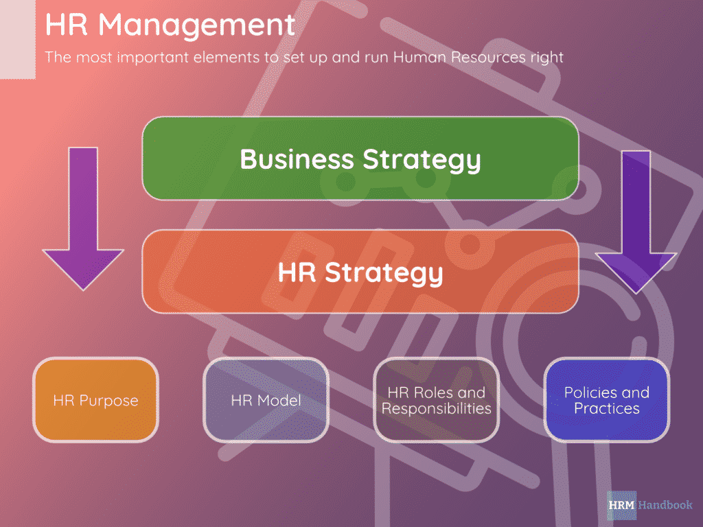
Needs Assessment: Name of Project | Name of your group
Student Names | date
 | k
Highlights from the Situational Analysis (bullet points short phrases with action verbs)
Situational analysis reveals strengths and weaknesses of a company
Volunteers support and funding drives most of the functions and operations.
Organizational structure of the company is strong
Highlights from Benchmarking & Best Practices (bullet points short phrases with action verbs)
  Selective hiring helps to invest in people
  Employees engagement leads to success to HRM
  KPIs must be used to evaluate outcomes of management
Overview of Micro-level Gap Analysis (Visual or Image Representation of Stakeholders – avoid word phrases, could be a picture or SmartArt)
Overview Meso-level Gap Analysis (bullet points short phrases with action verbs)
Need to establish a strong communication network between management and workforce
Effective training to meet with the needs of diverse workforce
Management
Workers
Overview of Macro-level Gap Analysis
(bullet points short phrases with action verbs)
Changes to the current diverse workforce management standards
Establish centralized authority culture to avoid interpersonal conflicts
Create differentiation
volunteers

