Slide 1
Project Three: Executive Summary Report
Student Name:
Course
Date

Slide 2

Introduction
The presentation communicates Fiat Chrysler’s decision.
The company considers diversifying into the US aerospace industry.
It focuses on Partnering with Archer Aviation.
The diversification will increase sales and improve company’s performance.
Notes:
The project outlines how Fiat Chrysler is going to diversify its business portfolio to bolster its revenues and financial performance. The automaker is considering venturing into the aircraft design and engine manufacturing. The decline in automobile sales in the United States has necessitated Fiat Chrysler to invest in new the industry to widen its revenue sources. The company focuses on partnering with Archer Aviation to realize this quest

Slide 3
Business Presentation: Key Message
Key message is Fiat Chrysler’s venture into aircraft design and engine manufacturing business.
The company will use rational decision-making model.
It new business portfolio will benefit both the organization and stakeholders.
Notes:
Following the decline in automobile sales in the United States, Fiat Chrysler is considering diversifying its business portfolio to increase sales and revenues. The company focuses on investing in the aerospace industry due various opportunities that it offers. Chrysler's experience in engine manufacturing is a driving force to enter the market. Ideally, the automaker will apply rational decision-making approach to reach to an informed choice. Venturing into the design of aircraft and engine manufacturing is expected to enhance organization’s financial performance and benefit owners, employees, investors, customers, and suppliers.

Slide 4
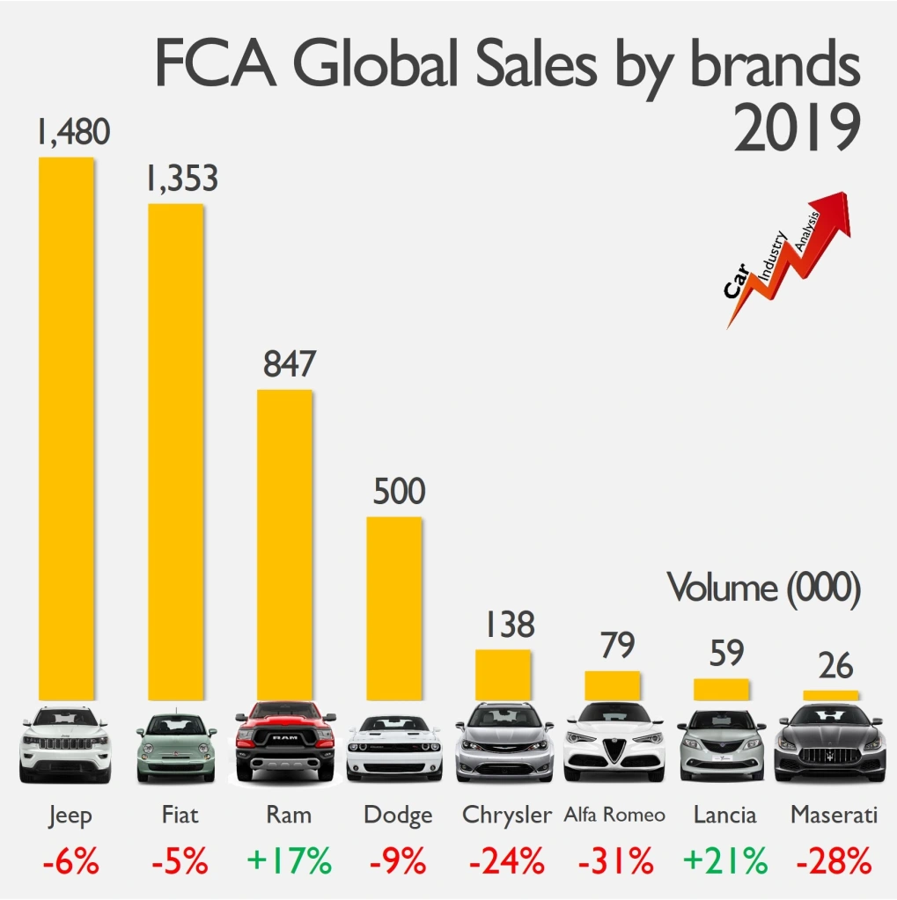
Key Points
Automobile sales has declined in the last 3 years.
US sales dropped to 14 million in 2020.
Chrysler sales declined by 17.4%.
Notes:
The US automobile industry a slow growth and declining sales in the last three years. The industry recorded the lowest sales of 14 million units in 2020 down from 17 million units in 2019 due to the impact of the Covid-19 pandemic. Individual automakers, including Fiat Chrysler (FCA), has also suffered a decline in sales and revenues. For instance, FCA’s US sales dropped by 17.4 percent in 2020 compared to the previous year (Wayland, 2021). This is the lowest performance as related to the industry performance of 15 percent decline.

Slide 5
The Story
The US automobile industry is shrinking.
There are many competitors.
The consumers have shifted to BEVs and HEVs.
Hence, FCA should diversify to aircraft and engine manufacturing to overcome the challenges.
Notes:
The US automobile industry was adversely hit with the impact of the Covid-19 pandemic in 2020. Even so, the market was becoming saturated due to high concentration of well-established automakers in the market that pose stiff competition to Fiat Chrysler. Similarly, the consumers have shifted to sport utility vehicles (SUVs), battery electric vehicles (BEVs), and hybrid-electric vehicles (HEVs). Therefore, there is need for FCA to diversify to new business portfolio to increase its sales and revenues.

Slide 6
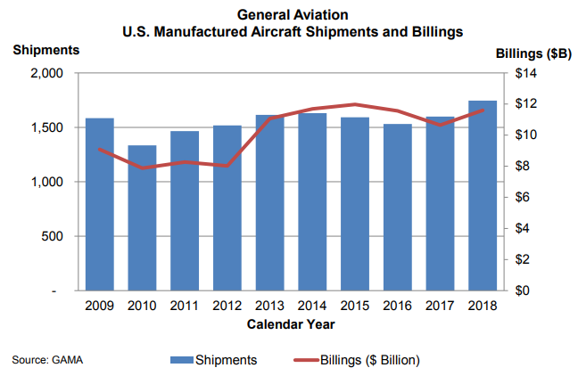
Diversification Decision: The Story
US aerospace industry is growing.
It expected to grow by 29.8% in 2021.
The shipment of turbine and turboprop aircraft is increasing.
Notes:
The US aerospace industry provides an opportunity for FCA to bolster its sales and revenues. Over the years, the industry has recorded a descent growth due to huge defense budget and increasing demand of commercial airplanes in the regional and international markets. IBIS World (2021) indicates that the industry will grow by 29.8 percent in 2021. This will be bolstered by the rising shipment of aircraft manufactured in the US. For instance, there were over 1500 shipments in 2018 contributing to about $12 billion in billings (FAA, 2018).

Slide 7
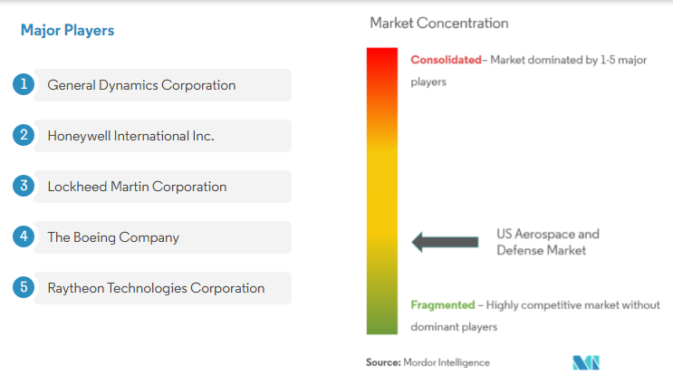
Likelihood of Success
The new business portfolio is likely to succeed.
Favorable growth.
Few competitors.
Specialization in A&D.
Notes:
Fiat Chrysler is more likely to succeed in the new industry. The aircraft and engine manufacturing is undergoing significant growth due the development of the commercial and defense industry segments. Mordor Intelligence (2021) predicts that the industry will grow by 2.37 percent CAGR between 2021 and 2030, reaching $550 .78 billion. The company will also face few competitors in the market. Currently, Boeing, Lockheed Martin Corporation, Raytheon Technologies Corporation, Honeywell International Inc., and General Dynamics Corporation. Additionally, unlike the automobile industry, aircraft manufacturing involves acquisition and development (A&D) products with high margins.

Slide 8
The Impact of Moving to the New Industry
Impact on the Organization
Impact on Internal and External Stakeholders
Large customer base.
Increased sales and revenues.
Enhanced competitive advantage.
High ROI.
Better benefits and wages.
Increased corporate income taxes.
Notes:
The diversification of the business will benefit both the organization and stakeholders. Moving into the aerospace industry will enable FCA to access new customers, thus increasing its consumer-base. The company will also increase its sales and revenues. Crucially, the diversification of the business portfolio exposes the organization to more opportunities and reduces, enhancing its competitive advantage.
Consequently, internal and external stakeholders will benefit from the decision. For instance, investors will realize high return on investment due to increased sales and revenues. Similarly, employees will enjoy from better wages and benefits, while the government collects more taxes from the additional corporate income.

Slide 9
Recommendations: Summary Findings of the Research Performed
The US automobile industry is shrinking.
Automobile sales declined to 14 million in 2020.
Aircraft manufacturing industry is growing.
It is expected to reach $550.78 billion by 2030.
Notes:
The findings indicate that the US automobile industry is declining due to the reduction in sales and revenues. The industry realized the lowest sales in 2020 of 14 million units from 17 million units in 2019. Conversely, the US aerospace industry has recorded significant growth in the last five years due to increased US defense budget and rise in commercial aircraft. It is expected that the aircraft manufacturing industry will reach $550.78 billion by 2030 (Mordor Intelligence, 2021).

Slide 10
Research Conclusions and Reasoning
US automobile industry is no longer lucrative.
Aircraft manufacturing provides an opportunity for diversification.
MEA and AEA are key expected growth areas in the industry.
Notes:
The conclusion of the research is that the US automobile industry is no longer lucrative as it was in the past. The saturation of the market as evidence by the declining sales and revenues shows that the sector is shrinking. Another conclusion is that the aircraft manufacturing industry provides an opportunity for Fiat Chrysler to diversify its business portfolio and reduce the risks currently experiencing in the automobile sector. This is because there are several unexploited growth areas in the industry, including more electric aircraft (MEA), all electric aircraft (AEA), and the autonomous flight systems.

Slide 11
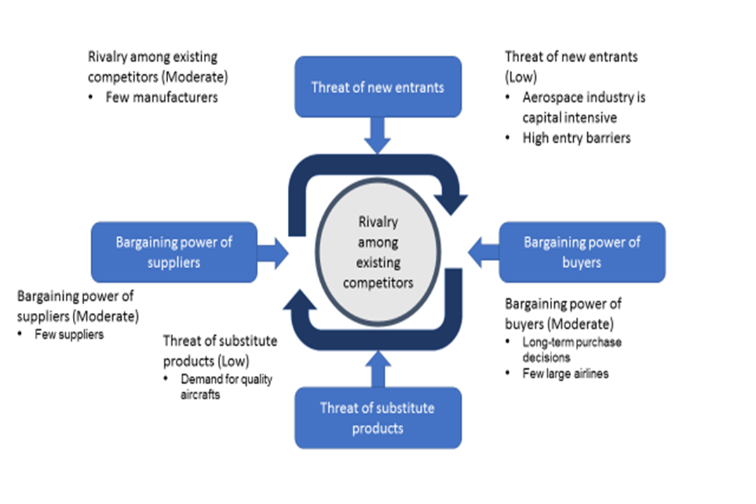
Rationale Behind Decision and Solutions
Growth opportunities.
Few competitors.
High product margins.
Notes:
The decision to diversify into aircraft manufacturing business is based on the opportunities that the sector provides. Unlike the automobile industry which has become saturated, aerospace industry has several opportunities that yet to be exploited. Secondly, there are a few industry players and low threat of new entrants in the industry, giving the company high likelihood of succeeding. Moreover, the cost of airplanes is high providing better margins.

Slide 12
References
FAA. (2018). FAA Aerospace Forecast: Fiscal Years 2019-2039. Federal Aviation Administration, https://www.faa.gov/data_research/aviation/aerospace_forecasts/media/fy2019-39_faa_aerospace_forecast.pdf
IBISWorld. (2021). Car & Automobile Manufacturing in the US - Market Size 2005–2027. https://www.ibisworld.com/industry-statistics/market-size/car-automobile-manufacturing-united-states/
Mordor Intelligence. (2021). US aerospace and defense market - growth, trends, covid-19 impact, and forecasts (2021 - 2030). https://www.mordorintelligence.com/industry-reports/us-aerospace-and-defense-market
Wayland, M. (2021). Fiat Chrysler’s U.S. auto sales tumbled 17.4% in Covid-ravaged 2020. CNBC, https://www.cnbc.com/2021/01/05/fiat-chryslers-us-auto-sales-tumbled-17point4percent-in-covid-ravaged-2020.html

