Slide 1
The influence of fashion on the young generation

Slide 2
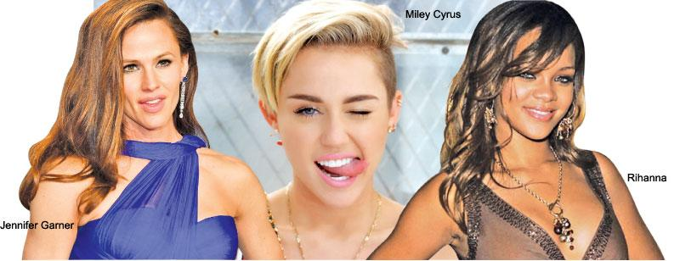
Fashion can be described as the everyday way of dressing. For instance, a common dress code or common color which was not there before is fashion (Nouri, M. 2018). There are two ends of fashion
  Classic which does not change, it is indefinite
  Fad- a fashion that quickly fades does not last
Fashion is common to the youth who are influenced by
  Celebrities
  Movies
Notes:
Every person is fashion conscious. Fashion is very popular among the school boys and girls. They do it in a competitive spirit to look smart, up-to-date and attractive. Students like actors and actresses.

Slide 3
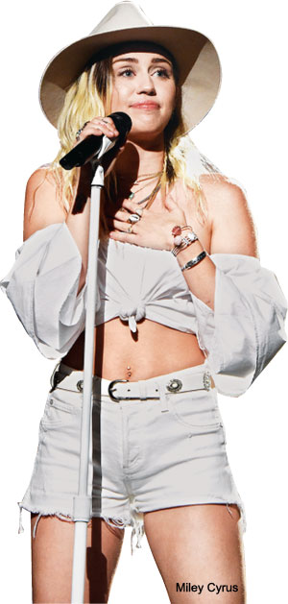
Celebrity lives
Celebrities are in all places and their eye-catching way of life, art, music, and literature and their influential effect on an individual’s life may certainly sway teenage minds, their principles, interests, conduct and their fashion tendencies (Tolentino, L. 2016).
As for girls, they imitate celebrities for the beauty, the profligate lifestyles and make up that that celebrity women use.
For the boys, they do it for the physiques and intense fashion and fame they aspire to have.
Celebrities design and effect fashion styles and design selections of the youth since superstars imply ideal beauty (Tolentino, L. 2016).
Notes:
Most wide spread clothing trends are first seen when celebrities wear them. Young people get their inspiration from people who they look up to and who they desire to be like.

Slide 4
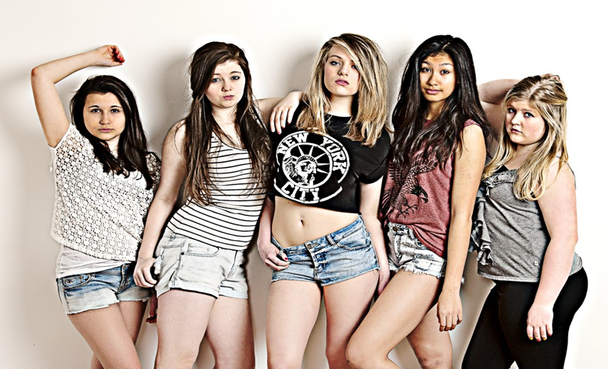
Influence from media
Social media and TV show vast roles in the way personalities sway the youth.
  Some are movies are devoted to fashion and the hosts remark on celeb fashion and criticize the flairs that they do not like.
  Teenagers mostly get swayed away by simply watching the movies performedby the celebrities (Nouri, M. 2018).
  In movies and music famous women like Miley Cyrus and Rihanna charm the young girls with their hairstyles and edgy scandalous styles
Notes:
Famous people have always shaped fashion trends throughout history and this is still true today. Fashion trends are catching on faster than in older generations due to the rise of social media.

Slide 5


Impacts of fashion
Good influence
The youth tend to feel confident especially when before others, due to the way their look with classy wears.
Bad influence
However, some youths crave for attention and for example when young girls wear sexual clothes, they seem to act in a cheeky way, resulting in inappropriate treatments.
Notes:
Clothes are characterized by symbols with a strong impact. For example, when teenage girls wear high heels or when men wear suits, they feel independent and have a better self esteem.

Slide 6
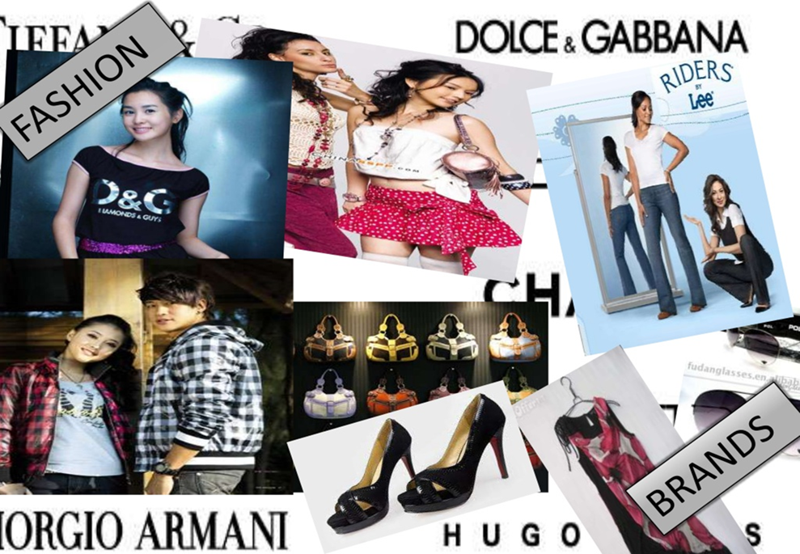
conclusion
Fashion alters the way young people dress, act, think and deviates their way of life as well. Youths tend to view celebs as their role models but unfortunately, not all youths know how to pick the upright models. Majority of personalities or models in the present day display too much of their skin in the name of fashion thinking it is the way it shoud be (Nouri, M. 2018).
Notes:
They need to learn that fashion is a good thing which helps the human being to improve, but it can also have a bad influence if they don’t know when and where to stop.

Slide 7
References
Nouri, M. (2018). The power of influence: Traditional celebrity vs social media influencer.
The influence of celebritIEs on youth. (2021, May 2). Retrieved from Sunday Observer: http://www.sundayobserver.lk/2018/04/22/yv/influence-celebrities-youth
TOLENTINO, L. (2016, july 27). Fashionology mag. Retrieved from The Influence Of Fashion On Teenagers: https://www.fashionologymag.com/influence-fashion-teenagers/

